Slide 1
Life Expectancy and per Capita GDP from 1952 - 2007
Kai Bartlette

Slide 2
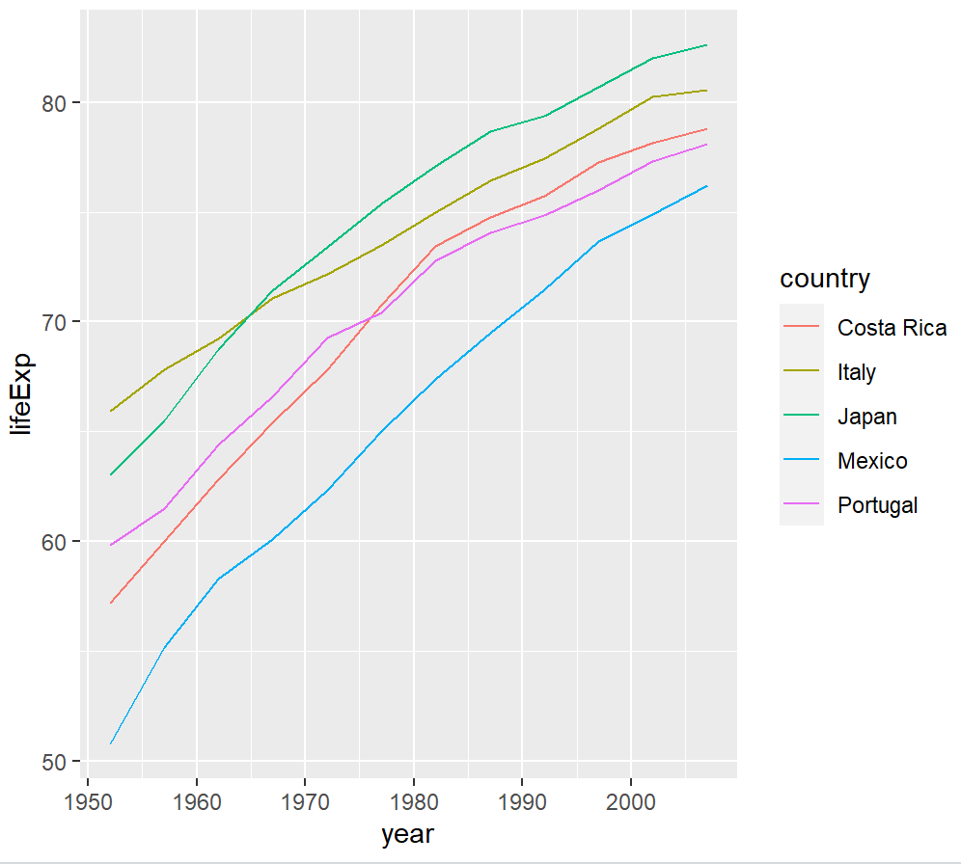
Life Expectancy for a Five Country Sample

Slide 3
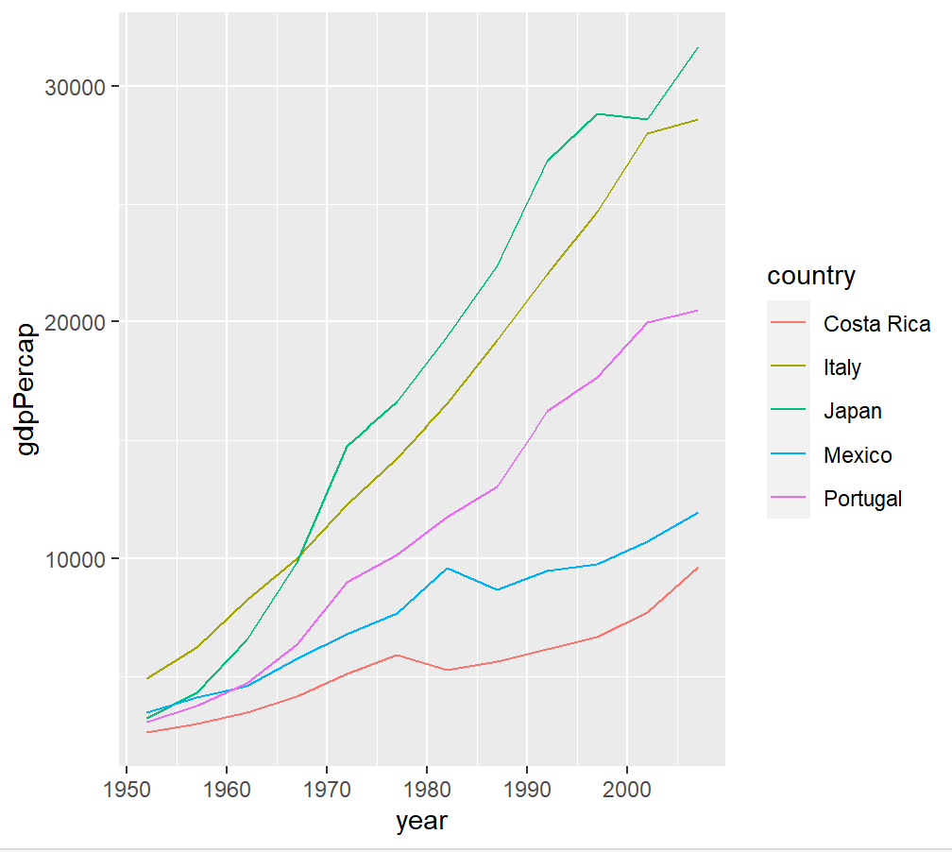
Gross Domestic Production for a Five Country Sample

Slide 4
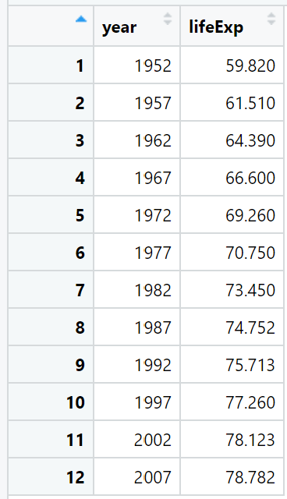
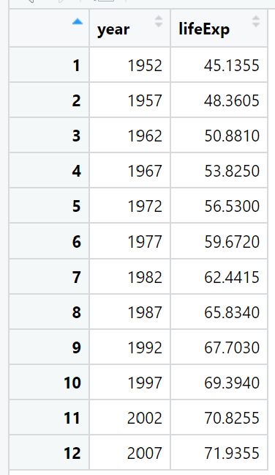
Median Life Expectancy for a Five Country Sample vs. 142 Countries
Japan, Portugal, Costa Rica, Italy, and Mexico’s median life expectancy was consistently above that of the median of the 142 countries as a whole.

Slide 5
Improvements in our health and healthcare have risen life expectancies across the globe.
“
”
Kai Bartlette

